Slide 1
Dynamic Programming

Slide 2
Dynamic programming - examples
A robot can jump to at most 2 blocks. If now it is on block 1,
how many different jumps can it make to reach block n.
. . .
1
2
3
4
5
. . .
n-2
n-1
n

Slide 3
Dynamic programming - examples
A robot can jump to at most 2 blocks. If now it is on block 1,
how many different jumps can it make to reach block n
. . .
1
2
3
4
5
. . .
n-2
n-1
n
P(n) = P(n - 1) + P(n – 2)
p[1] = 1
p[2] = 1
for i = 2 to n
p[i] = p[i - 1] + p[i- 2]

Slide 4
Dynamic programming - examples
A robot can jump to at most 2 blocks further. If now it is on block 1,
how many different jumps can it make to reach block n without
jumping onto red blocks.
. . .
1
2
3
4
5
. . .
n-2
n-1
n
red[i] = true if block i is red.
p[1] = 1
p[2] = 1
for i = 2 to n
if(red[i])
p[i] = 0
else
p[i] = p[i - 1] + p[i- 2]
P(n) = P(n - 1) + P(n – 2)

Slide 5
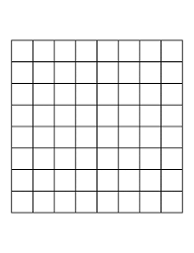
Dynamic programming - examples
How many different ways are there from s to d?
S
d

Slide 6
Dynamic programming - examples
1
m
How many different ways are there from s to d?
1
S
w[n][m] = number of different ways from 1,1
to n,m
w[n][m] = w[n][m - 1] + w[n - 1][m]
w[1][i] = 1, for all i <= m
w[i][1] = 1, for all i <= n
n
d

Slide 7
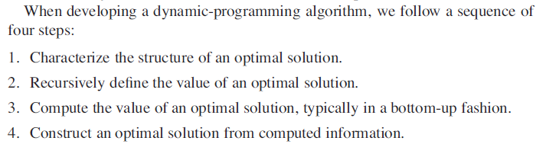
Dynamic programming - examples
Optimization problems

Slide 8
Dynamic programming - examples
Optimization problems
1
m
1
S
Given profit from each cell p[i][j], find a path
from s to d that brings max revenue?
r[n][m] = max revenue from [1,1] to [n,m]
r[n][m] = max(r[n][m - 1],r[n - 1][m]) + p[n][m]
r[1][i] = Sum(p[1][j]), for all j <= i
r[i][1] = Sum(p[j][1]), for all j <= i
n
d

Slide 9
Dynamic programming - examples
Maximum subarray problem: Given an array A of integers, find contiguous subarray within A which has the largest sum.
For example, A = < -5, 2, -4, 5, -1, 3, 4, -3, 2 >
Output: subarray < 5, -1, 3, 4 > with sum = 11
Solutions:
Find all possible subarrays and sums: O(n²) time
Use divide-and-conquer method: T(n) = 2T(n/2) + O(n) ➔ T(n) = O(nlgn)
Use dynamic programming technique (Kadane’s algorithm)

Slide 10
Dynamic programming - examples
Maximum subarray problem: Given an array of integers, find contiguous subarray within it which has the largest sum.
Kadane’s algorithm
For example, A = < -5, 2, -4, 5, -1, 3, 4, -3, 2 >
max_subarray(A)
max_cur = A[1]
max_so_far = A[1]
for i = 2 to n
max_cur = max(A[i], max_cur + A[i])
max_so_far = max(max_so_far, max_cur)
return max_so_far
1
2
3
4
5
6
7
8
9
max_cur
-5
2
-2
5
4
7
11
8
10
max_so_far
-5
2
2
5
5
7
11
11
11

Slide 11

Dynamic programming - examples
The rod-cutting problem: Given a rod of length n inches and a table of prices p_{i} for i = 1, 2, …, n inches, determine the maximum revenue r_{n} obtainable by cutting up the rod and selling the pieces.
For example
r₄ = ?
r₄ = p2 + p2 = 5 + 5 = 10

Slide 12
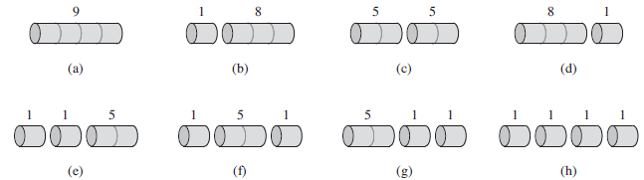
Dynamic programming - examples
In how many different ways can we cut up a rod of length n?
For example n = 4
Answer = 2^{n-1} different ways
So, T(n) = Ω(2^{n})

Slide 13
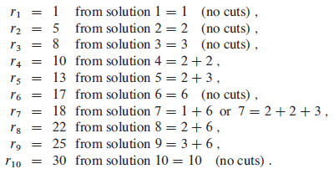
Dynamic programming - examples
If we need to divide the rod into k pieces to get the max revenue, then optimal decomposition is
n =i₁ + i₂ + i₃ + …+ i_{k}
And max revenue r_{n} = p_{i1} + p_{i2} + …+ p_{ik}

Slide 14

Dynamic programming - examples

Slide 15
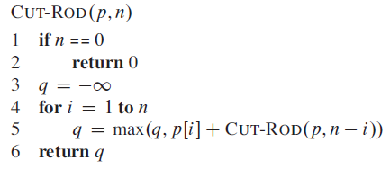
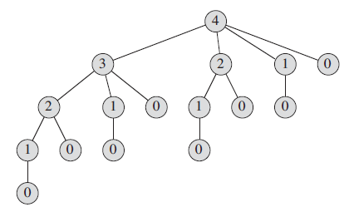
Dynamic programming - examples
Recursive top-down implementation

Slide 16


Dynamic programming - examples
Recursive top-down implementation

Slide 17
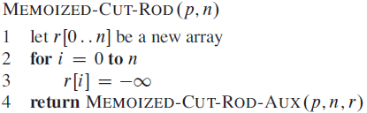
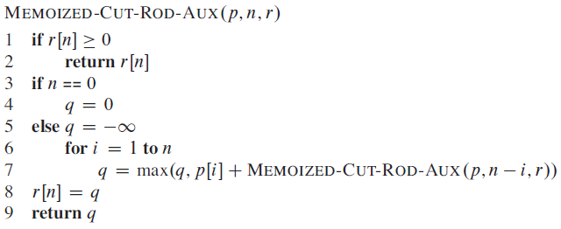
Dynamic programming - examples
Naïve recursive solution is inefficient as it solves the same subproblem repeatedly.
Use dynamic-programming technique
Remember already solved subproblems

Slide 18
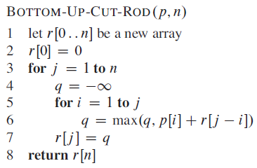
Dynamic programming - examples
Naïve recursive solution is inefficient as it solves the same subproblem repeatedly.
Use dynamic-programming technique
Remember already solved subproblems

Slide 19
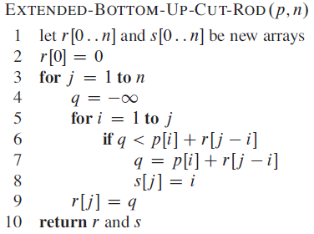
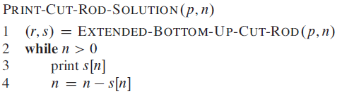

Dynamic programming - examples

